Slide 1
James 3:13-18
13Who is wise and understanding among you? Let him show it by his good life, by deeds done in the humility that comes from wisdom. 14But if you harbor bitter envy and selfish ambition in your hearts, do not boast about it or deny the truth. 15Such "wisdom" does not come down from heaven but is earthly, unspiritual, of the devil. 16For where you have envy and selfish ambition, there you find disorder and every evil practice. 17But the wisdom that comes from heaven is first of all pure; then peaceloving, considerate, submissive, full of mercy and good fruit, impartial and sincere. 18Peacemakers who sow in peace raise a harvest of righteousness.

Slide 2
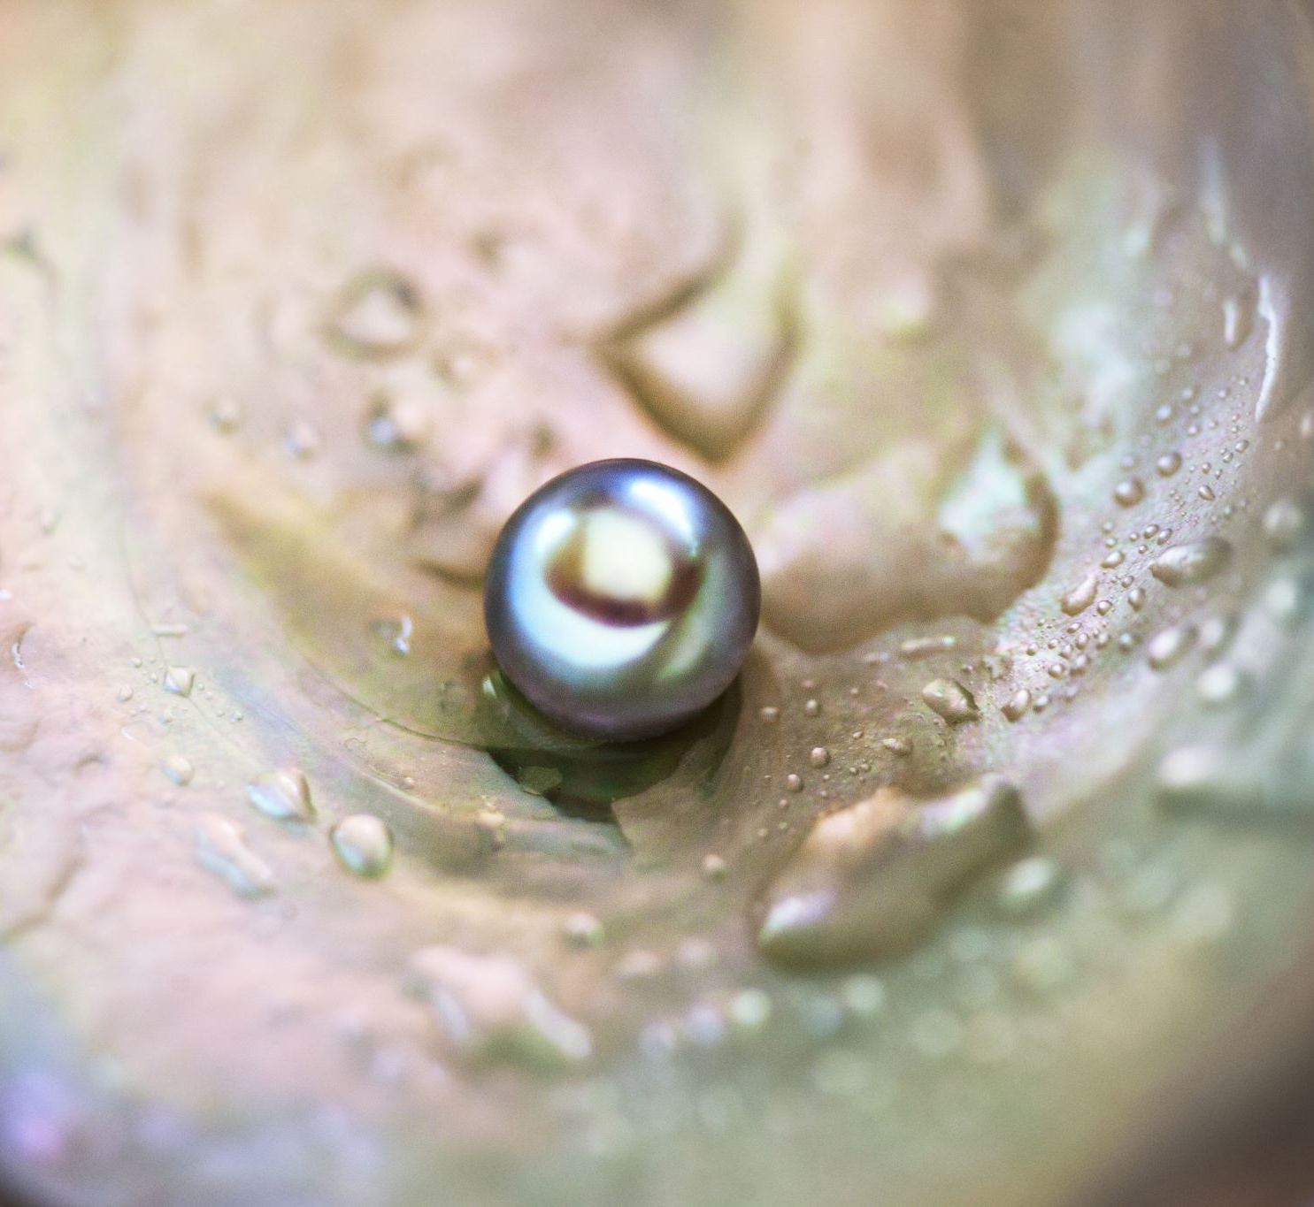
Pearls from James
October 16th
Tom Kenneally
James 3:13-18
Two Kinds of Wisdom

Slide 3
Pearls from James
James 3:13-18
The story found in 1 Kings 3 describes a time when two women came to the King Solomon.
Both lived together and both had babies days apart, unfortunately one passed soon after.
The mother who had lost their child swapped babies in the middle of the night, so they had come to both try to claim the child as theirs.
King Solomon “decided” that they should cut the baby into two so each mother could have a part of the child.
The real mother gave up the child to spare them, where as the other mother agreed to this.
Solomon then awarded custody to the one willing to sacrifice for the child, recognising they must be the true mother.

Slide 4
Pearls from James
James 3:13-18
The author James, was:
An early church leader, particularly of the church of Jerusalem.
Known as James the Just, and respect through out the early Church community.
The Brother of JESUS

Slide 5
Pearls from James
James 3:13-18
James starts with a question
In James’ time envy didn’t always mean a negative thing
James’ finishes this off by saying under the surface of this “Wisdom”, you’ll find disorder and evil things.
James then marks out the characteristics of someone who is wise.

Slide 6
Pearls from James
James 3:13-18
Wisdom as defined by Modern Society: the quality of having experience, knowledge, and good judgement; the quality of being wise.
Wisdom as defined by Ancient Society: Someone who is experienced in either life or a certain aspect of it, or being skilled in a particular area.
Wisdom as defined by Biblical Literature: Someone who lives an integrated life, where their values and actions align and those values stem from God the true source of Wisdom.

Slide 7
Pearls from James
James 3:13-18
Earthly Wisdom:
Lofty and Unreachable, Typically only Intellectual or self focused
Harder to see, or point out examples of.
You either have it or you don’t.
True Wisdom:
Practical and grounded in reality
Has a visible quality where others should be able to point it out
Something you build within yourself, a habit that you work on.

Slide 8
Pearls from James
James 3:13-18
Earthly Wisdom:
Demands to be recognised
Rarely allows room for other opinions
True Wisdom:
Speaks primarily through actions
Typically acts in a way that is not focused on the self but on others.

Slide 9
Pearls from James
James 3:13-18
True wisdom is:
Pure or Holy
Peace-loving: Prioritises relationships
Considerate or Humble: Meets the needs of others before the self
Submissive: Allows others to suggest the next course of action
Full of mercy: Recognises the imperfection in others and seeks the good in them
Impartial: Does not favour one over the others
Sincere: Truly seeks to love others well.

Slide 10
Pearls from James
James 3:13-18
How can you transform your relationships:
Do you need to create more Peace?
Do you need to consider others needs above your own?
Do you need to put others suggestions above your own?
Do you need to let others off the hook more?

Slide 11
Pearls from James
James 3:13-18
May God bless us with discomfort At easy answers, half-truths, and superficial relationships So that we may live from deep within our hearts. May God bless us with anger At injustice, oppression, and exploitation of God’s creations So that we may work for justice, freedom, and peace. May God bless us with tears To shed for those who suffer pain, rejection, hunger, and war, So that we may reach out our hands to comfort them and To turn their pain into joy. And may God bless us with just enough foolishness To believe that we can make a difference in the world, So that we can do what others claim cannot be done: To bring justice and kindness to all our children and all our neighbors who are poor. Amen.

